Slide 1
Operations Management

Slide 2
Today’s Agenda
Part 1
A General Overview to Operations Management
Part 2
A complimentary but more specific view of Operations Management

Slide 3
Part 1
A General Overview to Operations Management

Slide 4
What is Operations Management?
Management discipline that deals with the design and management of products, processes, services and supply chains. It considers the acquisition, development, and utilization of resources that firms need to deliver the goods and services their clients want.
Operations management is responsible for translating and executing an organisations objectives, policies and strategies in to day to day operations.
Ultimately Operations management is responsible for delivering the performance objectives of the organisation.

Slide 5
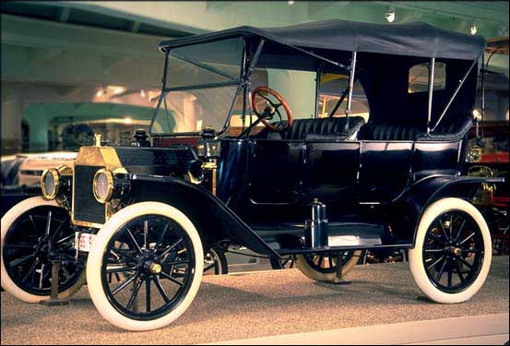
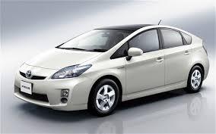
Operations Management - Background
Machine that changed the world
Womack and Jones, 1991
Lean thinking
Womack and Jones, 2003
“Any colour you want as long as it is black”

Slide 6
Operations Management - Background
People… necessary evil … … … … … … … … key asset
FW Taylor
Management by
objectives
Balanced
ScoreCard
Triple
bottom-line
Henry Ford
MRP
MRPII
ERP
Production
Engineering
eSCM
Work Study
Maintenance
management
Machine that changed the world
Womack and Jones, 1991
Lean thinking
Womack and Jones, 2003
TPM
“Any colour you want as long as it is black”
Method Study
5S
Layout
Planning
Group
technology
Cellular
Manufacturing
SMED
Simplification
JIT
Manufacturing
Toyota Production
System
Lean
Variety
Reduction
OPT
TOC
QC
QA
TQM
Business
Excellence
SQC
SPC
Tagucchi
6-Sigma
Product and Production Driven
Market Driven
Market Driven… Waste Focused
00s 20s 40s 60s 80s 00s 20s

Slide 7
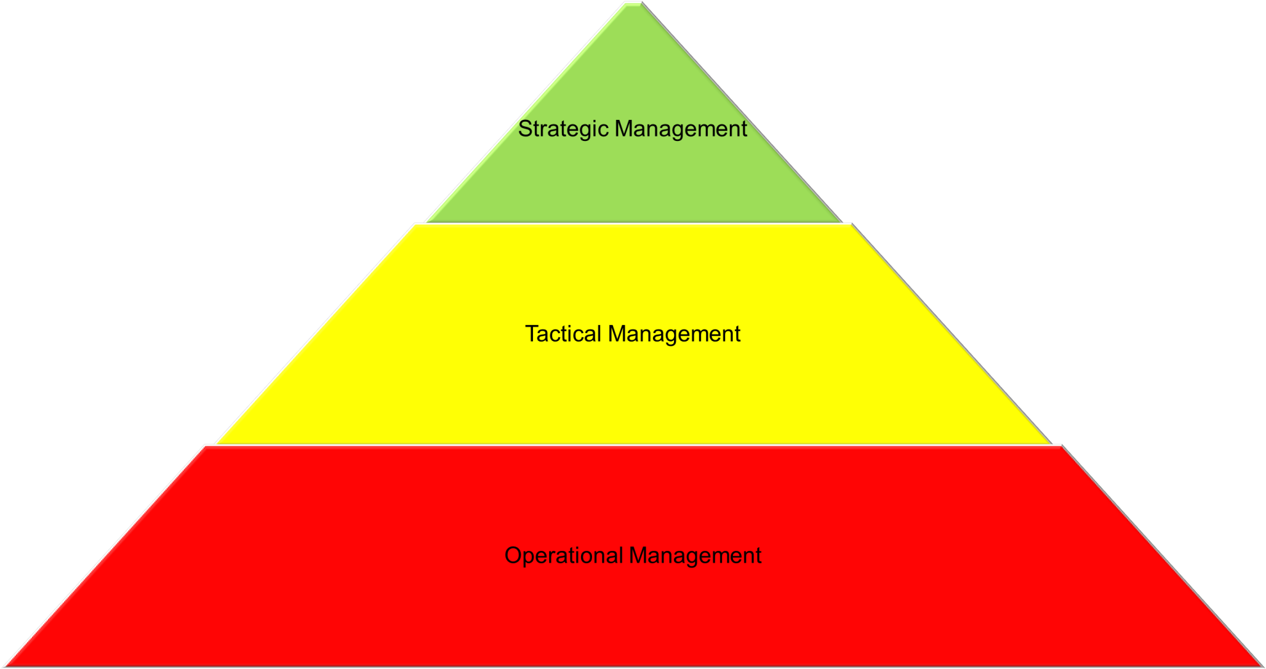
Levels of Business Management
Notes:
Strategic issues - size and location of plants, deciding the structure of service networks, and designing supply chains.
Tactical issues - plant layout and structure, project management, and equipment selection and replacement.
Operational issues - work scheduling and control, inventory management, quality control and inspection, traffic and materials handling, and equipment maintenance policies.

Slide 8
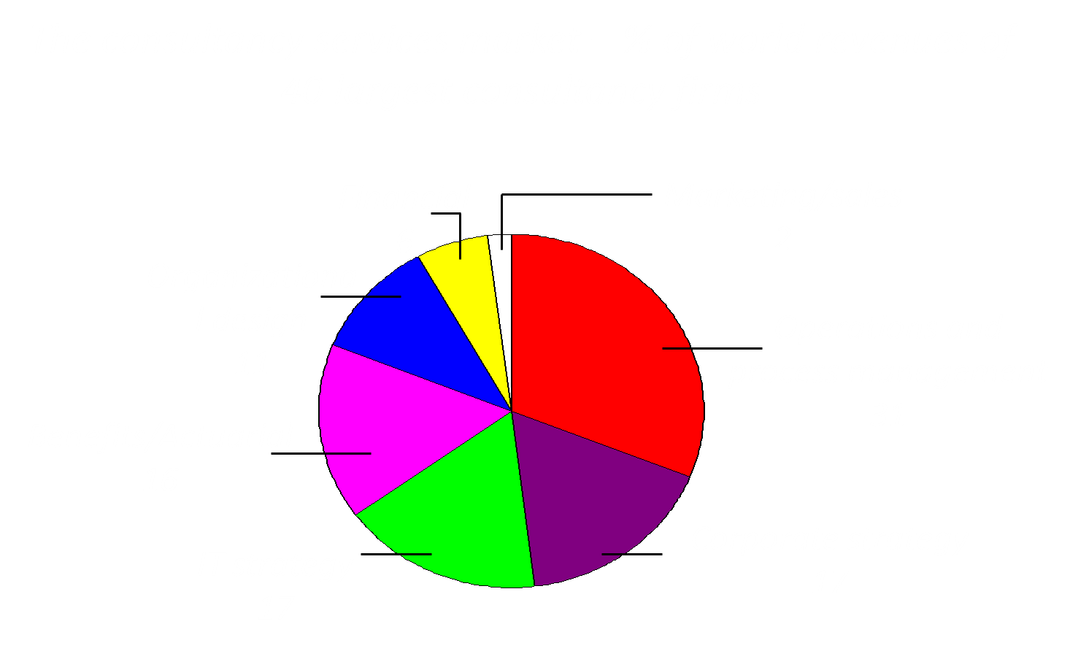
Operations management is fashionable!

Slide 9
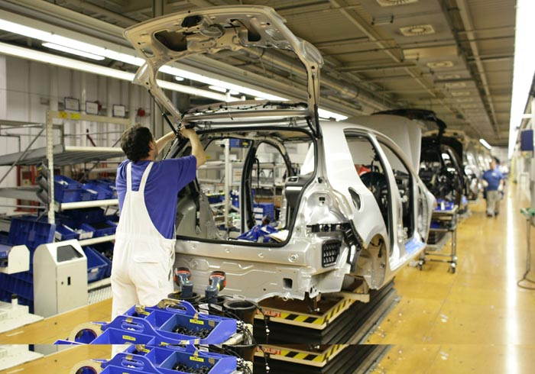
Operations management uses…
machines
to
efficiently
assemble
products
diagnose conditions
to treat real and perceived patient concerns
knowledge
to
effectively
people
to
effectively
create
services that will address current and potential client needs
ours and our partners’ resources
to
speedily
provide
supplies and services that relieve community suffering
our staff’s knowledge and experience
to
creatively
present
ideas that delight clients and address their real needs
Notes:
Activity of managing the resources to create and deliver products and services.

Slide 10
Core functions of Operations Management
Organization/
Enterprise
Operations
Marketing and Sales
Product/ Service development

Slide 11
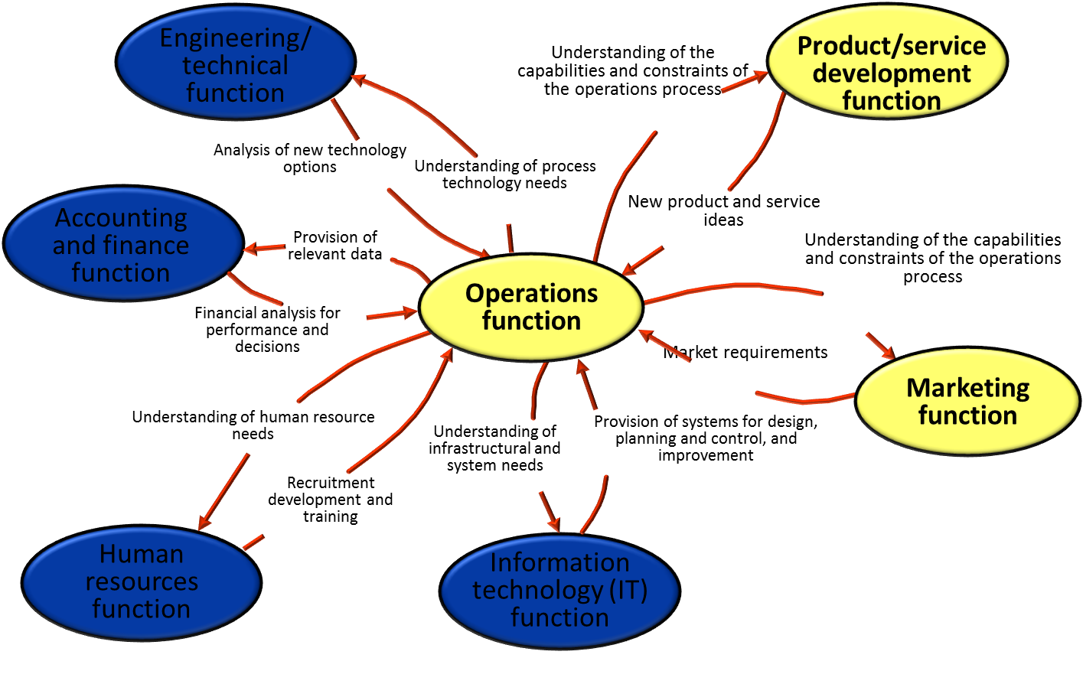
Inter-functional relationships between operations and other functions

Slide 12
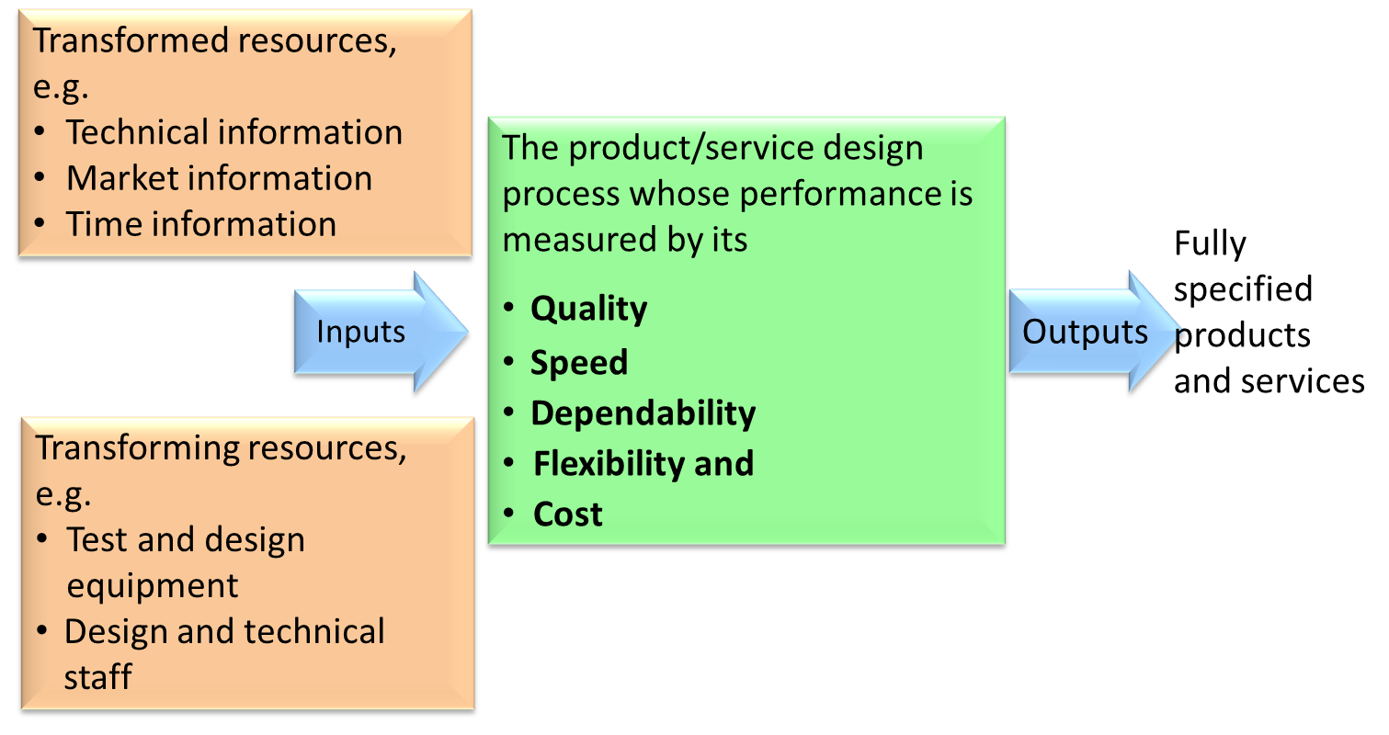
The product and service design

Slide 13
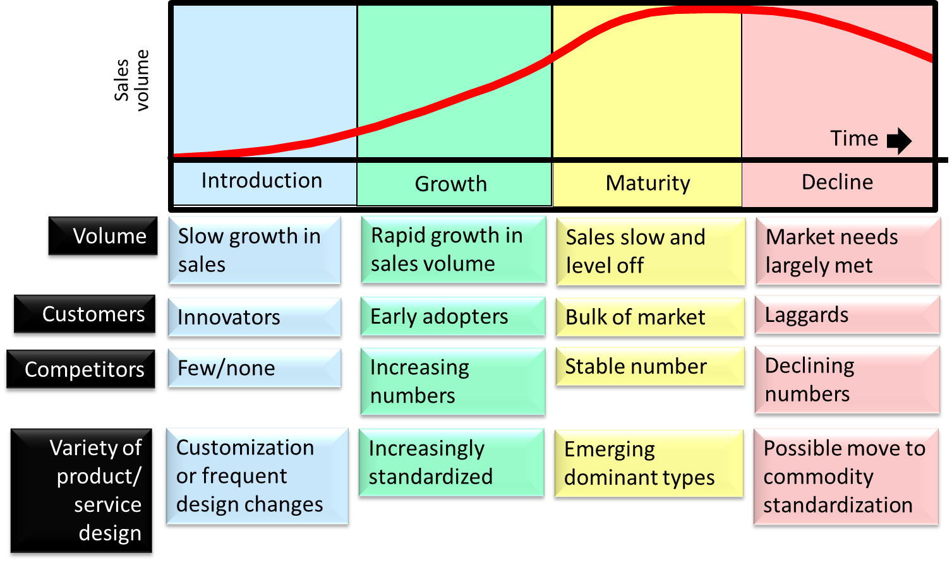
The effects of the product / service life cycle
Notes:
6

Slide 14
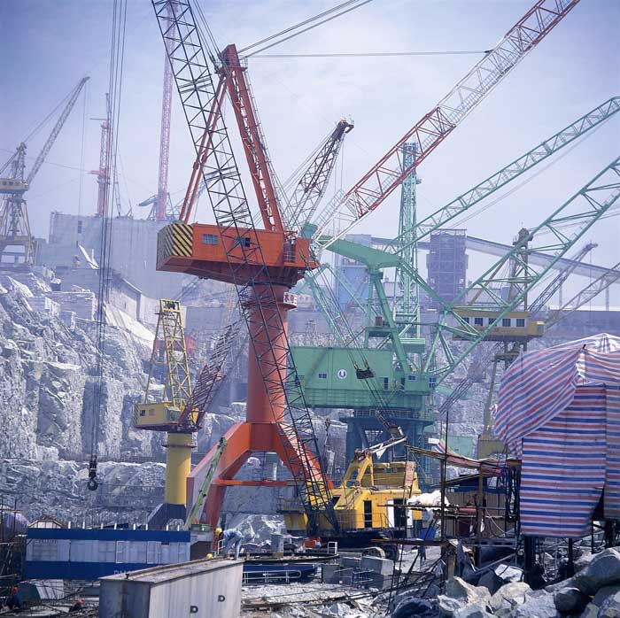
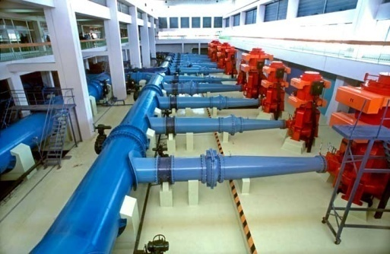
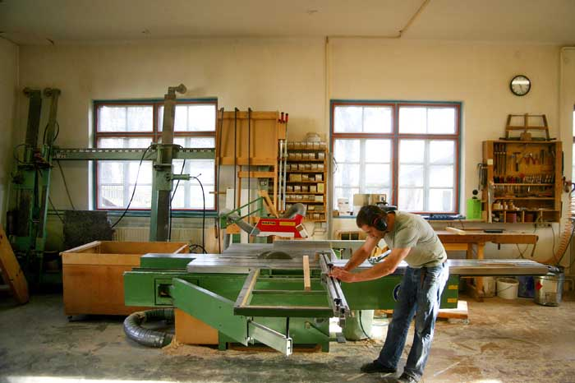
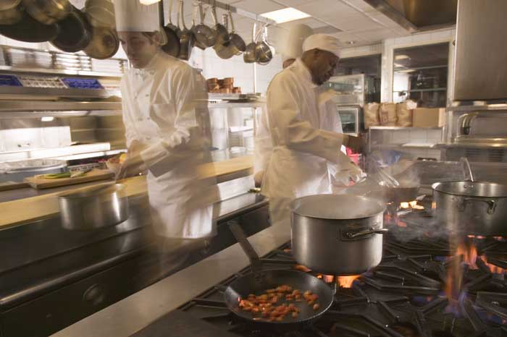
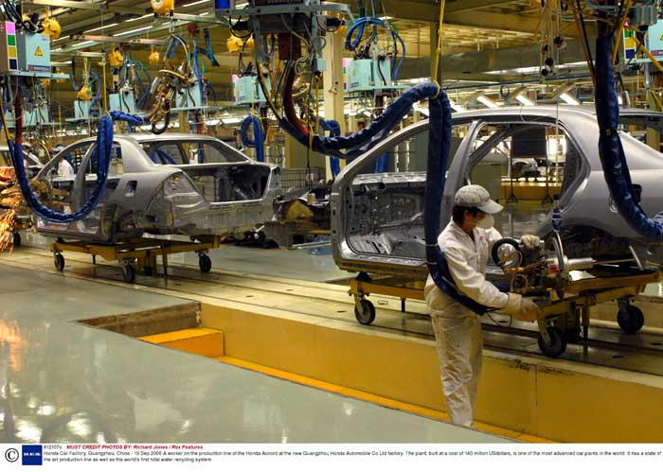
Products and manufacturing processes
Diverse/ complex
Intermittent
High
Project
Jobbing
Process tasks
Batch
Process flow
Variety
Mass
Contin-uous
Repeated/ divided
Continuous
Low
Low
Volume
High

Slide 15
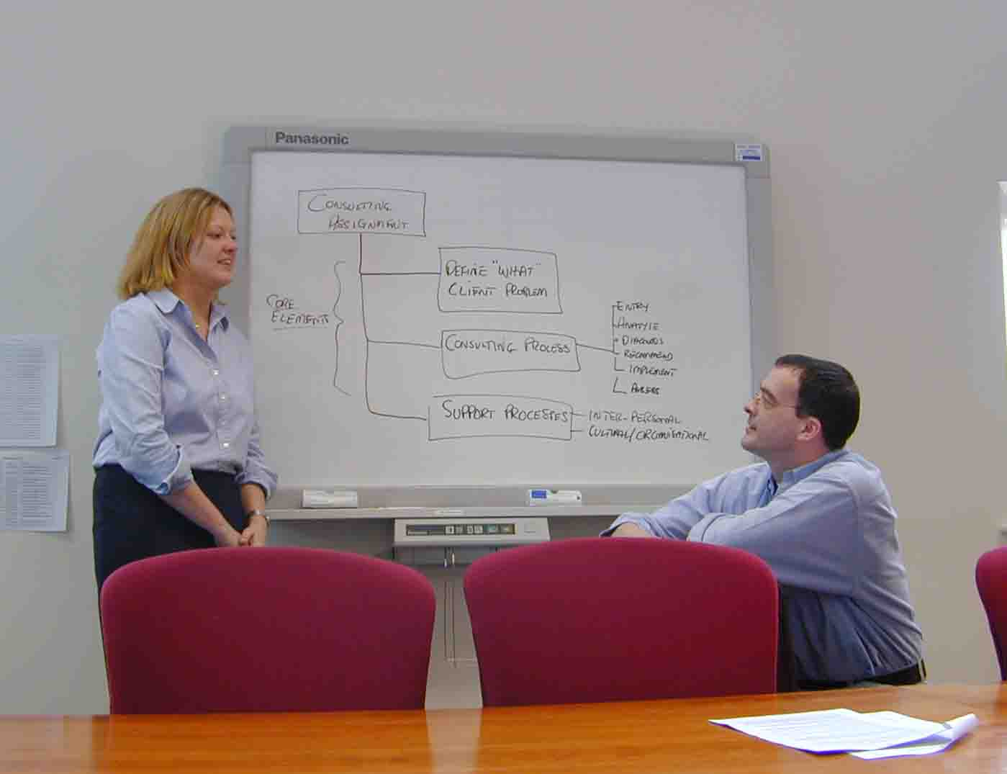
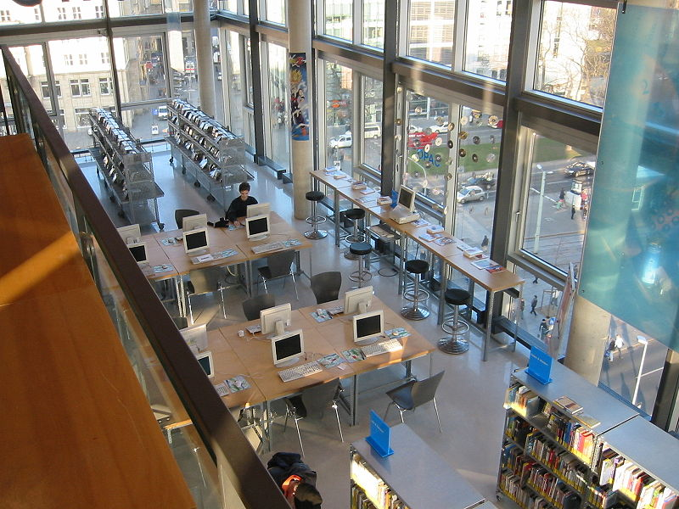
Services and service processes
Diverse/ complex
High
Professional service
Intermittent
Project
Jobbing
Service shop
Process tasks
Process flow
Variety
Batch
Mass
Mass service
Contin-uous
Repeated/ divided
Continuous
Low
Low
Volume
High

Slide 16
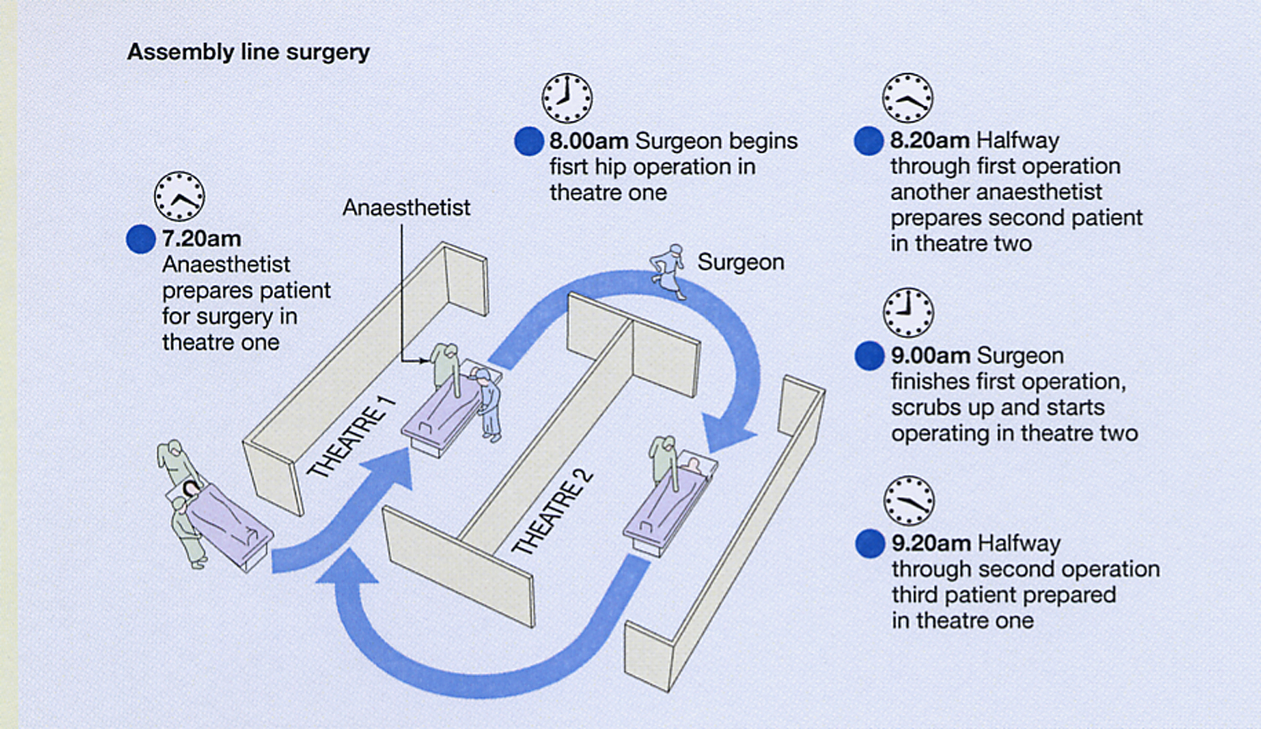
Design of a manufacturing/service system for optimum flow

Slide 17
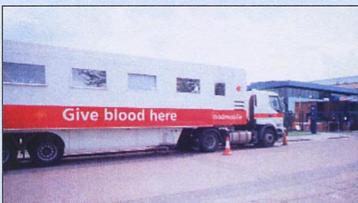
Inventory Management
Inventory: An item or product kept in stock for future use having certain cost value.
Rate of supply from input process
Inventory
Rate of demand from output process
Input process
Output process
Inventory

Slide 18
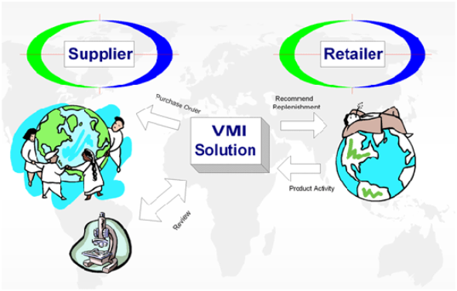
Strategies to for balancing Demand and Supply
Operational efficiency
Time compression
Postponement, JIT
E-Business
Online business transactions
Information sharing
EDI, ERP
Channel alignment
Vendor Managed Inventory (VMI)
All images taken from internet sources

Slide 19
Supply Chains - Material & Information Flows
Manufacturing
Warehouse
European Supplier
Warehouse
Warehouse
Latin American
Suppliers
Other Suppliers
Warehouse

Slide 20
Operations performance seen as
whole supply chain issue
Customer
II Tier Supplier
Wholesaler
I Tier Supplier
Distributor
Manufacturer
Retailer
Consumer
Benefits of looking at the whole supply chain include:
It helps an understanding of competitiveness.
It helps to identify the significant links in the network.
It helps focus on long-term issues.
It helps focus on cost.

Slide 21
Supply chain dimensions
Second tier supplier
First tier supplier
First tier customer
Second tier customer
End customer
Supply side
Demand side
Purchasing and supply management
Physical distribution management
Information & Finance flow
Physical flow
Logistics
Materials management
Supply chain management

Slide 22
Matching the supply chain with market requirements
Agile supply chain management
Mismatch
Supply network resources
Efficient
Responsive
Low cost – Fast response
High utilization – Low TP/utilization
Minimum inventory – Deployed inventory
Low cost suppliers – Flexible suppliers
Lean supply chain management
Mismatch
Nature of demand/Market requirement
Functional products
Innovative products
Predictable – Unpredictable
Few changes – Many changes
Low variety – High variety
Price stable – Price markdowns
Long lead-times – Short lead-times
Low margin – High margins

Slide 23
Quality Management
Quality up
Processing time down
Rework and scrap costs down
Image up
Service costs down
Inventory down
Inspection and test costs down
Sales volume up
Capital costs down
Complaint and warranty costs down
Price competition down
Scale economies up
Productivity up
Revenue up
Operation costs down
Profits up

Slide 24
Operations Improvement
Define–identify problem, define requirements and set the goal
Control–establish performance standards and deal with any problems
Measure–gather data, refine problem and measure inputs and outputs
Improve–develop improvement ideas, test, establish solution and measure results
Analyze–develop problem hypotheses, identify ‘root causes’ and validate hypotheses

Slide 25
Operations Management
Part 2
An alternative but complimentary view of Operations Management
It is all about Processes and Performance

Slide 26
Operations Management
Defined as…. a value-adding area of an organisation concerned with innovation, production and distribution of goods and services to customers whilst ensuring that the use of organisational resources remains efficient and effective. It is therefore a discipline that is critical to the sustainability of all organisations, industrial, service and public sector alike… and includes…
inventory management resources
constraint management
quality management
process improvement
Information systems
technology management
value chain management
supply chain management
manufacturing resources
productivity improvement
service management
lean systems/just-in-time
planning and scheduling
facility location and layout
job design
work measurement
forecasting and demand management
inventory management
outsourcing
performance measurement
logistics and distribution
innovation management
customer management
operations strategy
manufacturing strategy
project management
product design
process management
risk and reliability management

Slide 27
Operations Management
Defined as…. a value-adding area of an organisation concerned with innovation, production and distribution of goods and services to customers whilst ensuring that the use of organisational resources remains efficient and effective. It is therefore a discipline that is critical to the sustainability of all organisations, industrial, service and public sector alike… and includes…
Boring..!
Let’s look at this in a different way
inventory management resources
constraint management
quality management
process improvement
Information systems
technology management
value chain management
supply chain management
manufacturing resources
productivity improvement
service management
lean systems/just-in-time
planning and scheduling
facility location and layout
job design
work measurement
forecasting and demand management
inventory management
outsourcing
performance measurement
logistics and distribution
innovation management
customer management
operations strategy
manufacturing strategy
project management
product design
process management
risk and reliability management

Slide 28
What happens in and organisation?

Slide 29
In organisations
Public, Private, Commercial, Industrial, Charitable and so on…
people do things
With computers, machines, materials, information, paper, other people and so on...
that lead to results
Good or bad

Slide 30
For example…
Receive Order
Process Order
Check Credit
Plan
Order
Make Product
Test
Product
Deliver
Product
Install
Product
Train
Customer
Invoice
Customer

Slide 31
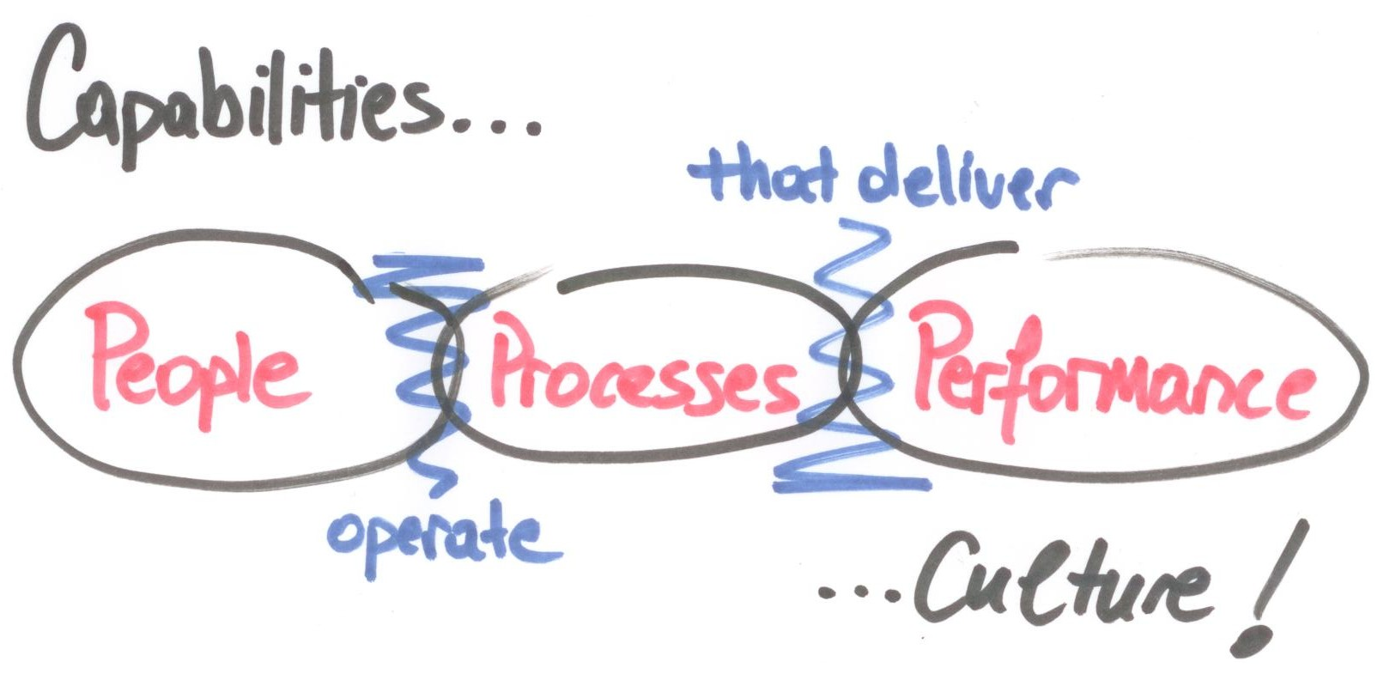
In organisations…

Slide 32
More contemporary definition…
Operations management is about realizing organisational goals and objectives through business processes

Slide 33
What is a Process?
A business process is a series of continuous or intermittent cross-functional activities that are naturally connected together with work flowing through these activities for a particular outcome/purpose.

Slide 34
Structure of a Process
Effectiveness
The extent to which the output meets specification/ requirements
Controls
Process
Inputs
Outputs
Resources
Efficiency
Resources consumed in producing the output?

Slide 35
Controls
Structure of a Process
Process
Inputs
Outputs
Resources
Activity
Activity
Activity
Activity
Activity
Activity
Activity
Activity
Notes:
Any process can be broken don in to sub-processes or activities… this can be done in different levels of detail.

Slide 36
Structure of a Process
Flow… the most important thing about a process!
Controls
Process
Flow
Inputs
Outputs
Resources

Slide 37
What is a business for?
How does it do that?
i.e. what does the business need to be good at?

Slide 38
Things that businesses need to be good at…
Products and services that customers want
Get orders for these products and services
Fulfil orders for these products and services
Provide aftersales support for these products and services
These are all processes

Slide 39
Things that organisations need to be good at…
Develop Product
Win Order
These are the four generic processes that underpin organisational competitiveness here and now for any organisation
Fulfil Order
Support Product

Slide 40
Things that organisations need to be good at…
Develop Product
Let’s talk about these in different kinds of organisation
Manufacturing
Bank
University
Win Order
Fulfil Order
Support Product

Slide 41
But what about performance in the future?
What do we do to sustain competitiveness in the long term?

Slide 42
Things that businesses need to be good at for sustaining competitive advantage
Be aware of what is happening around them… customers, competitors, suppliers etc.
Knowing what you are about… what business are you in
Planning for how you are going to sustain and develop your competitive advantage
Monitoring and managing how you are performing against these plans
Changing to new ways of doing things quickly
These are all also processes

Slide 43
Set Direction
Manage Change
Scan Environment
Manage Performance
Manage Strategy
Future competitiveness
Develop Product
Win Order
Fulfil Order
Competitiveness here and now
Support Product

Slide 44
Are there other processes?
Other things organisations do that we have not talked about

Slide 45
Set Direction
Manage Change
Scan Environment
Manage Performance
Manage Strategy
Managerial Processes
Future Competitiveness
Develop Product
Win Order
Fulfil Order
Operational Processes
Competitiveness here and now
Support Product
Support Processes
Supports operational and managerial processes
Support
…..
Support
HR
Support
…..
Support
Technology
Support
Finance

Slide 46
Business Processes
Science …v… Art
All processes have a scientific and artistic content
Scientific – rational, logical, codifiable
Art – cognitive, creative, non-codifiable

Slide 47
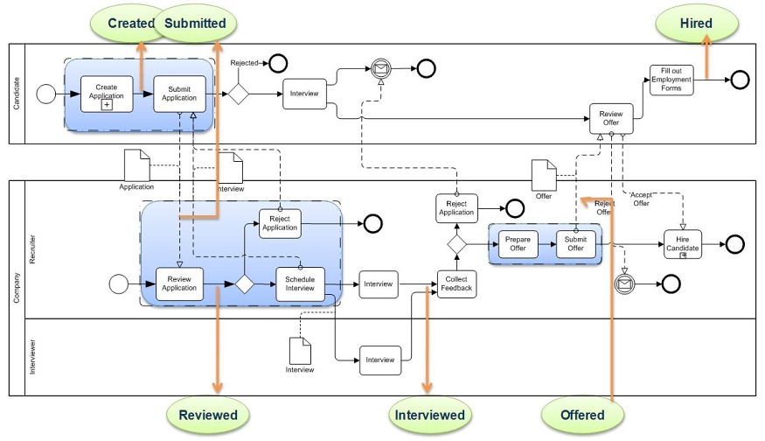
A mostly Scientific business processes
Hiring new employees
But what about or ability to interview and select the best person…?

Slide 48
A mostly Artistic business processes
Hiring new employees
Selection
Development
Implementation
Product Development Process
Ideas
Becomes more structured requiring some intuition and experience
Becomes quite mechanical
Starts with a highly creative process

Slide 49
Let’ not forget about people…!
With good people but badly designed processes you can still make it work…. Opposite is not so easy…!

Slide 50
In most organisations big percentage of the people work in operations…
… operations management is as much about managing people as it is to manage the processes

Slide 51
What kind of organisation would you like to work for?
Driven by measures and targets… Low levels of commitment to people
Structured with clear sense of purpose… people are valued and developed
Dictatorial…
Low levels of commitment to people
No sense of purpose… led by a charismatic leader

Slide 52
The surprising truth about what motivates us
http://www.youtube.com/watch?v=u6XAPnuFjJc

Slide 53
Lets talk about Performance
Effectiveness
The extent to which the output meets specification/ requirements
Controls
Efficiency and effectiveness are two dimensions of performance
Process
Inputs
Outputs
Resources
Efficiency
Resources consumed in producing the output?

Slide 54
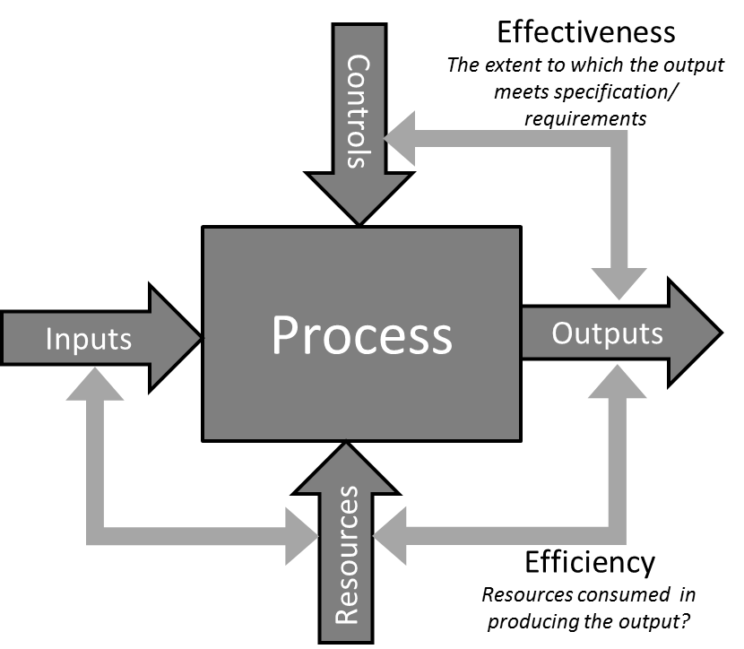
In Operations Management we tend to measure and manage performance
Leading indicators
e.g. supplier on time delivery
Leading indicators
e.g. schedule adherence
Leading indicators
e.g. On time delivery
Lagging indicators
e.g. customer satisfaction

Slide 55
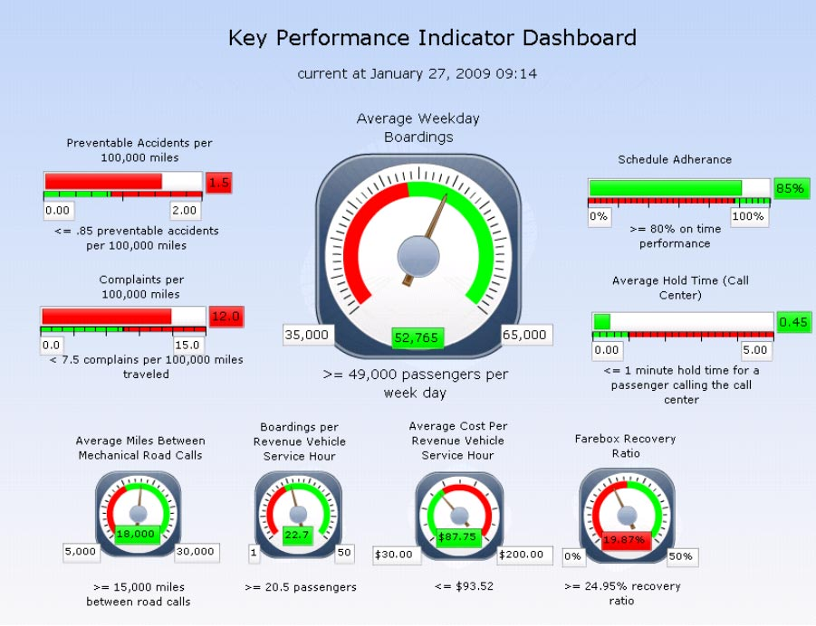
PMS examples

Slide 56
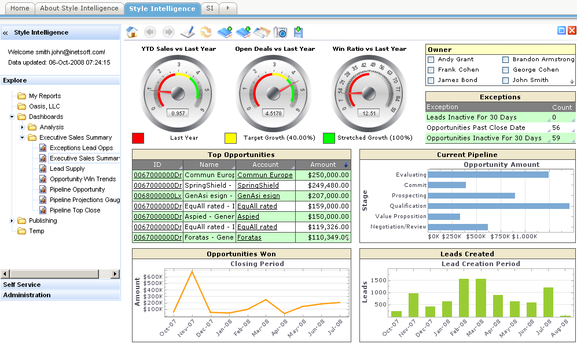
PMS examples

Slide 57
Development of performance measurement field
Performance measurement as a social system
Inter-Organisational
performance management
People and teams perspective of PM
Relevance Lost
(Johnson and Kaplan, 1987)
Integrated
Performance
Management
Environmental & social
performance
Integrated
Performance
Measurement
Performance measurement for innovation and intellectual property
Budgetary
Control
Performance
management in SMEs
Performance measurement in public sector and non-profit organisations
Balanced Scorecard
(Kaplan & Norton 1992)
Productivity
Management
1900 1920 1940 1960 1980 2000 2020 Time
Familiar period
procedures and control
Extrapolable period
management by objectives and long range planning
Familiar Discontinuity Period
periodic strategic planning
Novel Discontinuity Period
dealing with unpredictable surprises

Slide 58
The Balanced Scorecard
Performance measures used should be balanced across the four perspectives
Financial
measures
effectiveness
efficiency
Strategy
Customer
measures
Internal
process
measures
Learning
& growth
measures
capability
Notes:
Use the animations to explain the interconnections between various perspectives of balanced scorecard

Slide 59
Measurement
What we measure – how we report, review and act on measures
V
Management
How we use the measures to manage performance

Slide 60
Performance measurement and management is about organisational control… see organisational control theory
Technical Control
Performance Measurement
Individual survival
High Maturity
Growing together
Neo-liberal economic
organisation
Humanistic
organisation
Social Control
Performance Management
Weberian
Organisation
Charismatic
organisation
Command
and Control
Open Participative Self-Managed
Fear
Low Maturity
Love

Slide 61
Summary
On the one hand…
Operations management is a very broad discipline of management
It is about efficient and effective organisation of the firms resources
Fundamental to the organisations goals and objectives
It can involve complex global supply chains
Management of people is a key element of managing operations
On the other hand…
It is about managing the performance of processes
People are a key component of any process
Processes can be simple and within one firm or complex joining several firms together in a global supply chain
However you chose to look at Operations Management is about Designing and Managing Processes

Slide 62
Reading
Bititci, U., Garengo, P., Dörfler, V. and Nudurupati, S. (2012) Performance Measurement: Challenges for Tomorrow. International Journal of Management Reviews, 14(3), 305-32.
Bititci, U.S. et al. (2011) Managerial processes: an operations management perspective towards dynamic capabilities. Production Planning & Control, 22(2), 157-173.

